Slide 1


Mantid Framework and Examples of its use
Toby Perring
STFC www.mantidproject.org

Slide 2


Project History
July 2007 Requirements & Design
April 2008 V 1.0 First instrument support
Feb 2010 V1.1 Collaboration with SNS & HFIR & Support multiple techniques
Jan 2012 V2.0
Scientist validated results. VATES integration
May 2015 V3.4 Improved functionality and usability … Development Continues

Slide 3







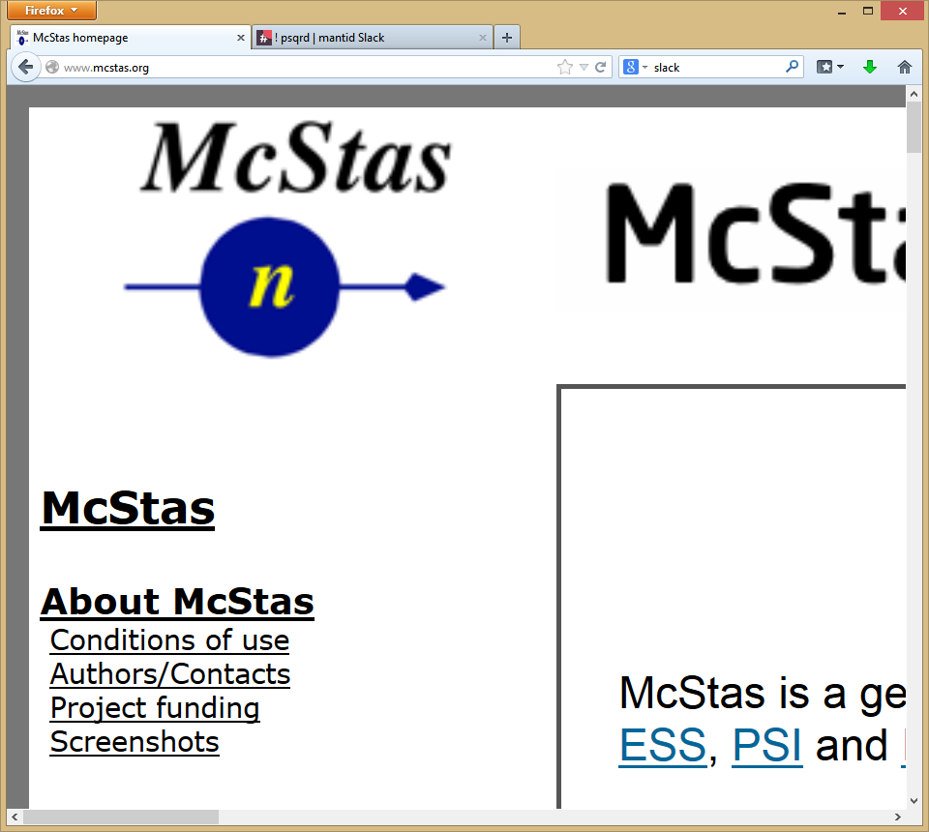
Contributors
Partners
Prime Contractor
Contributors

Slide 4
Project Goals
Goals
Consolidate the data reduction/analysis software for neutron/muon scattering
Without restricting the needs of the instrument scientists
Key requirements
Create a data reduction/analysis framework
not instrument or technique dependent
Cross-platform
Windows, Linux, Mac
Easily extensible
Freely redistributable
Open source
You can see what is going on
Good basis for collaboration

Slide 5
Design
Separation of Data and Algorithms
Encapsulated “User Code” in specific places
Algorithms
Workspaces
Use of interfaces to allow use of generic components
QTI plot
Gnu scientific library
Open CASCADE
Reuse of existing components
Careful memory management when handling large datasets
Sparse storage
File backed workspaces
Notes:
Reuse of existing components: QTI plot; gnu scientific library (FITTING); oPENcASCADE – TRIANGULATION open source CAD for instrument plotting (real time)
Very large datasets:
- Sparse storage; file backing

Slide 6

Architectural Design - Overview
Instrument log files
Python
Command line & Scripting interface
Mantid Framework
RAW data files
API
Algorithms
Workspaces
MantidPlot Graphing and analysis
NEXUS data files
User Defined
User Defined
DAE direct access
Future Instrument specific UI
Future Instrument specific UI
Notes:
Pros: all the work in the framework; multiple interfaces (because not everyone just wants to use Python; see esp: unknown future instrument UI)
c++ faster (and people complain)
Con: more work looking after memory man. w.r.t just python

Slide 7
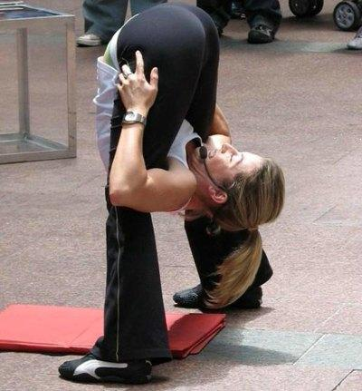
Flexibility - Framework
Instrument independence
Virtual instrument defined
Loaded from xml definition
Location, rotation and shape of every pixel
Sample
Source
Technique independence
Algorithms
Unit Reduction and analysis steps
Workflow scripts / Algorithms
Chain algorithms to perform a reduction workflow

Slide 8
Flexibility – Plug in extensions
Algorithm Dialogs Custom Interfaces Custom Menus
Algorithms
Unit Conversions
Fit Functions Cost Models Constraints Minimiser
Workspaces
Archive Searching LiveData Listeners Data Catalogues
GUI
Framework
(Framework) Utility
Notes:
GUI:interfaces in python;
Automatic GUIs when writing an algorithm
QT underneath any custom interfaces/menus [MantidPlot, but it is the only thing you would use anyway]
Workspaces and algorithms at run time
Algorithms: python (API), c++
Workspace: extend matrix, mdworkspace, tables (several variants under matrix: matrix2d, eventworkspace, single value). Written in c++
Fit functions in python
Interface with 3rd party code: do it within an algorithm.
Atomic Simulation Environment.

Slide 9




Professional Development
Professional Project Management
Dedicated software engineers
All with science BSc, many with PhD
Source code control in Github
Continuous build and testing
20+ build servers managed through Jenkins
World class static code analysis
Over 8,500 automated unit tests
Almost 300 automated system tests
Comprehensive documentation
Including 675 automated tests on included scripts
Both online and installed with Mantid

Slide 10
What we can do: Algorithms
~600
Arithmetic
Correction Functions
Absorption
Background
Efficiency
Data handling
Diagnostics
Calibration
Event Filtering
Optimisation
Transforms
Masking
Grouping
Smoothing
Unit conversions
Technique dependent
Single Crystal
Inelastic
SANS
Powder diffraction

Slide 11
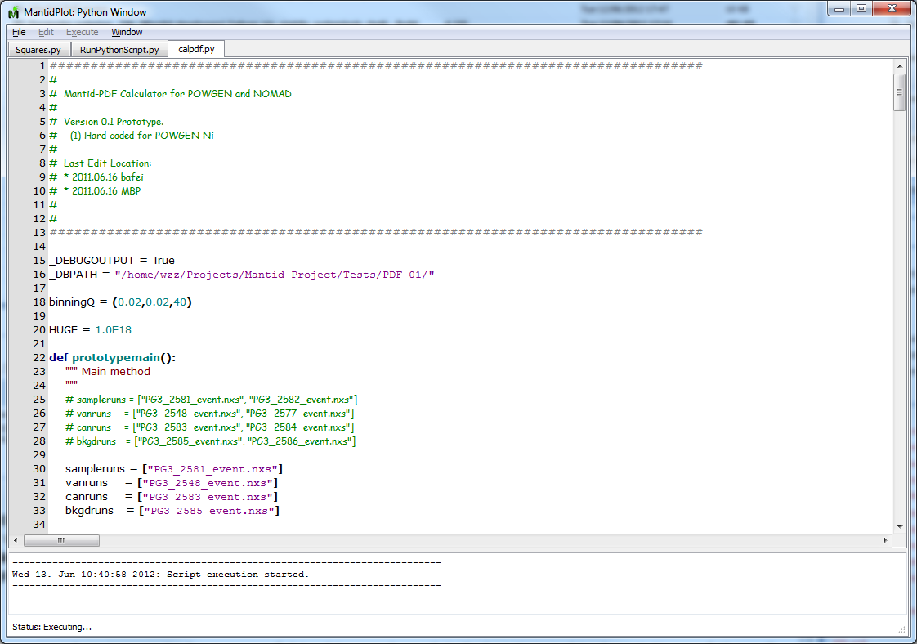
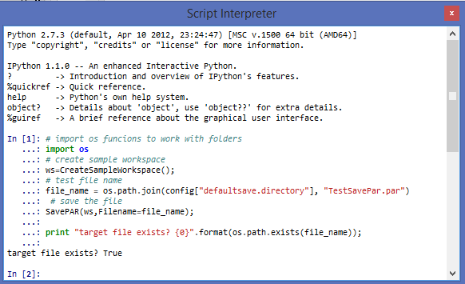
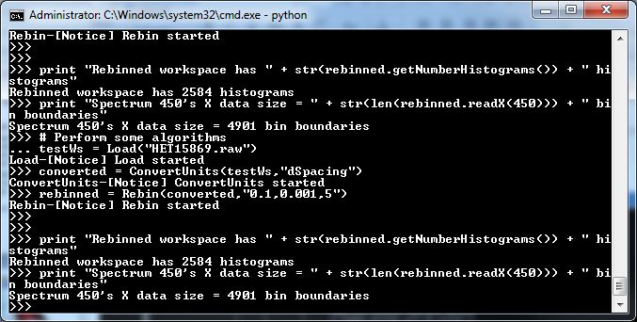
What we can do: Scripting
Scripts using the script window
Interactive via iPython
Can also be controlled direct from Python without a user interface

Slide 12
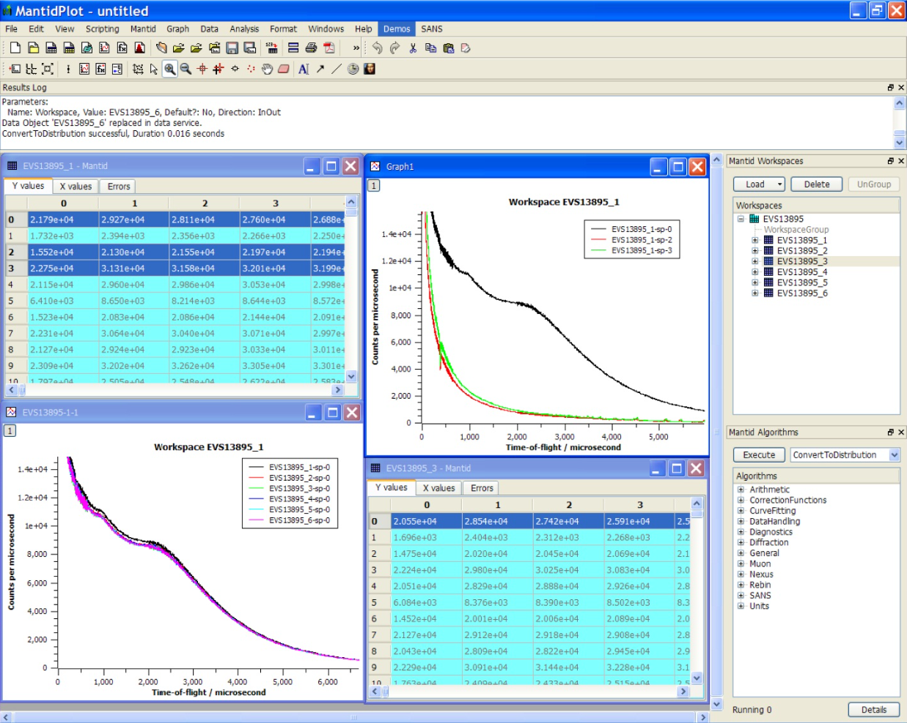
What we can do: MantidPlot

Slide 13
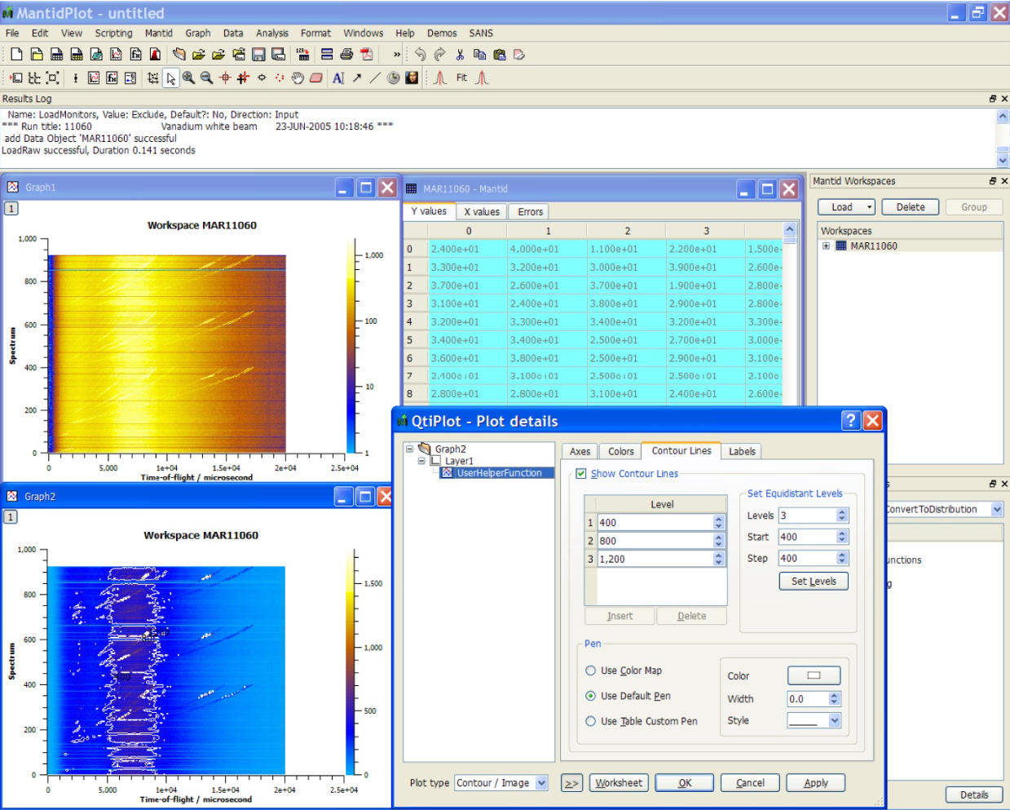
What we can do: MantidPlot

Slide 14
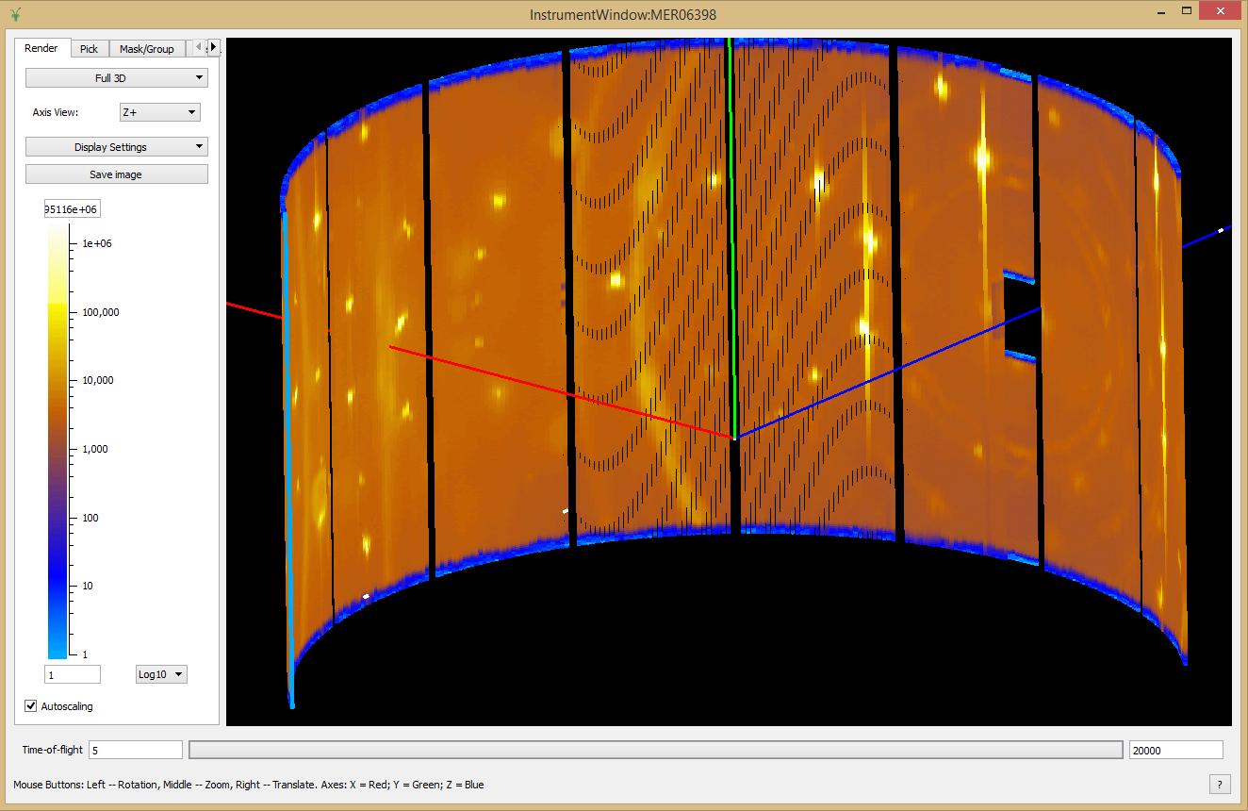
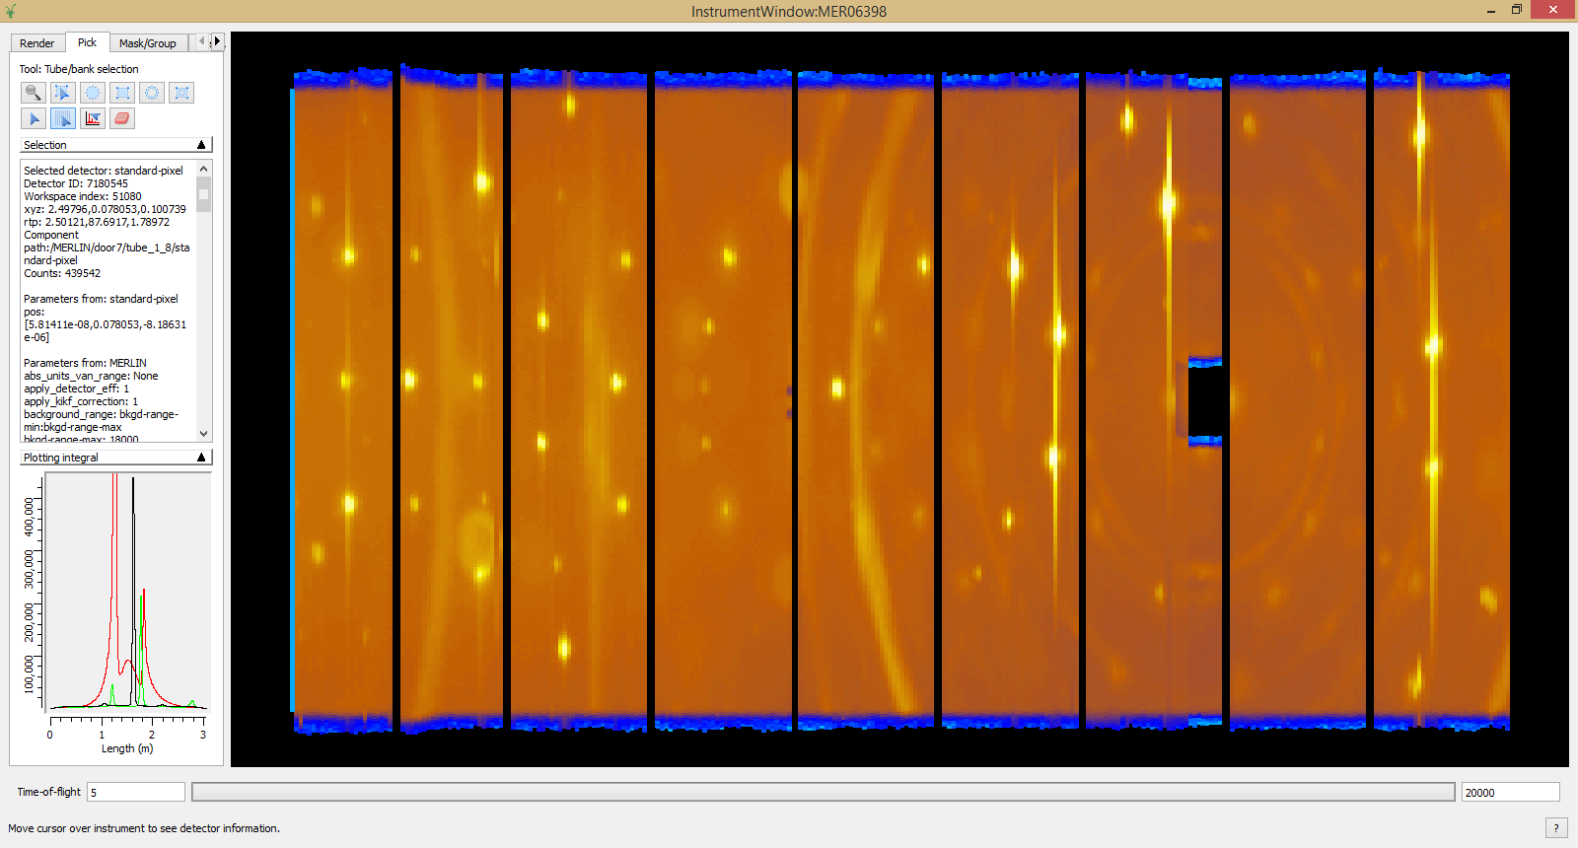
What we can do: Instrument View
Unwrapped 2D View
3D View

Slide 15
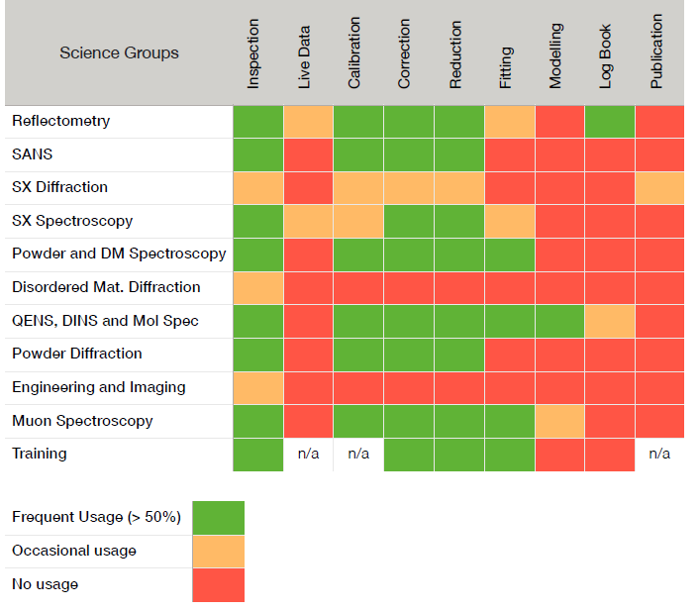
Use: ISIS
Notes:
The extent of uptake: depends on the need:
- Powder diffraction at ISIS: existing reduction code just too old and inflexible
Single crystal diffraction: WISH: The existing code for the SXD instrument powerful, but not able to cope with data volumes
Direct geometry spectrometers: Mixed Matlab/FORTRAN code that was too difficult to maintain
DG visualisation: HORACE means it has not been such a priority
All groups are interested to different levels: but have to prioritise resources.

Slide 16
Use: SNS
Beamlines | Inspection | Calibration | Reduction | Auto-Reduction | Fitting | Modeling | Live Data | Event Filtering | MantidplotPublication | Experiment Planning
USANS
Nomad
Basis
SNAP
REFM
REFL
CNCS
EQSANS
VULCAN
Corelli
Powgen
Mandi
Topaz
Hyspec
Vision
SEQUOIA
ARCS
>50% usage
Ocasional usage
No usage

Slide 17
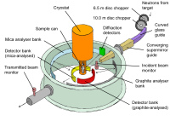
Data Analysis of QENS Experiments at ISIS
Experiments
Indirect Data Reduction
Both Scripting and GUI modes
Indirect Data Analysis
EISF
MSD
Bayesian Analysis (FABADA)
I(Q,t)
Fitting
Model Fitting
Data is transferable across facilities:
BASIS(SNS) and IN16B (ILL)
Corrections for absorption and multiple scatterings
Notes:
Absorption (cylinder, annulus,flat, plate) – from Spenser’s MODES program; Fortran=>python) [but no generic algorithms] ) (makes approximations)
Detector efficiency
EISF elastic incch scatt func
Fitting: exponential (I(Q,t), stretched exponential; Lorentian S(Q,w)

Slide 18
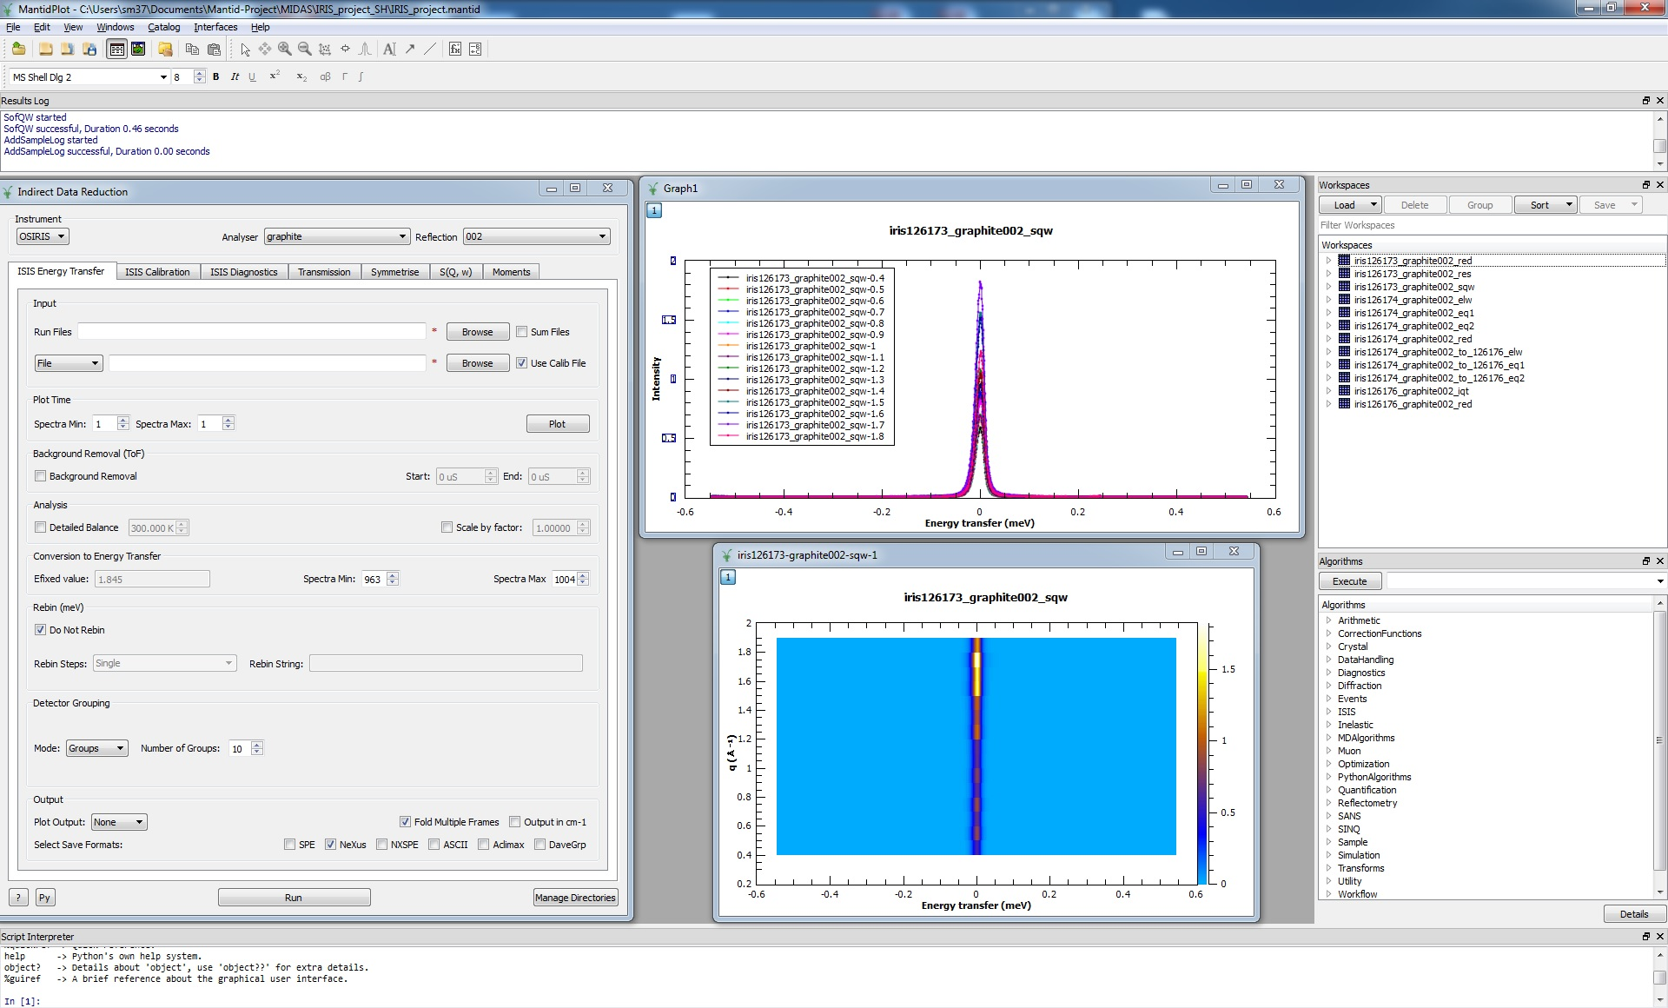
QENS Data Reduction in Mantid

Slide 19
QENS Data Reduction in Mantid

Slide 20
QENS Data Reduction in Mantid
Instrument
Analyser
Reflection
Transmission
Detectors

Slide 21
QENS Data Reduction in Mantid

Slide 22
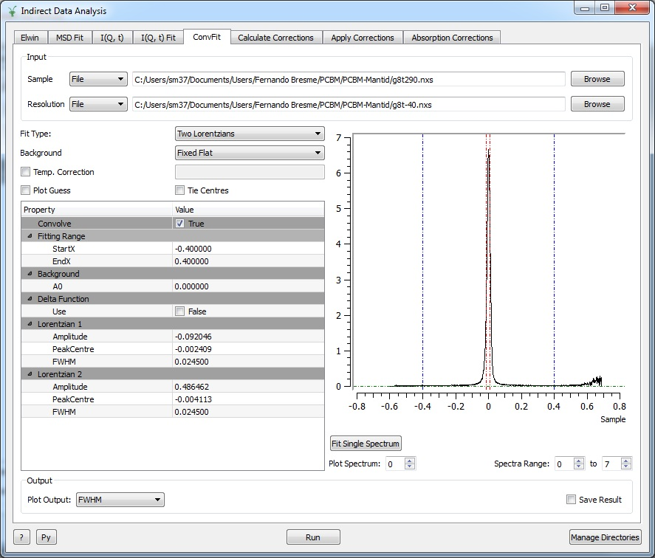
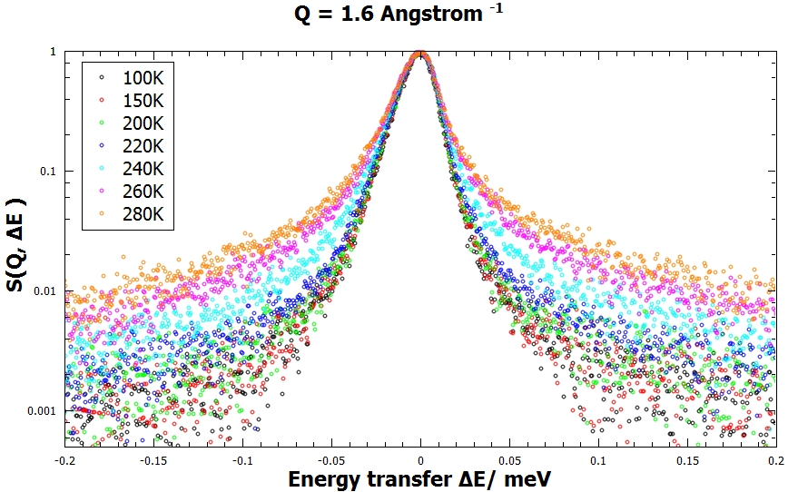
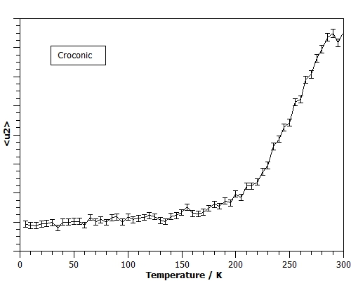
QENS Data Analysis in Mantid
EISF
MSD
I(Q,t)
Absorption corrections
S(Q,ω)
MSD
Interface for fitting S(Q,ω) on Mantid
Notes:
‘Py’ button gives you the script
Instrument resolution from vanadium S(q,w)
Compare I(Q,t), S(Q,w): robust; personal preference!!!!
MSD picture: Solid=>plastic=>liquid ; survey in express application to support major application.

Slide 23
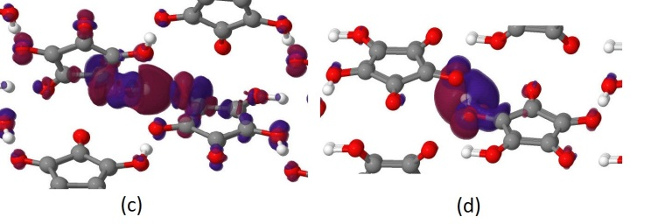
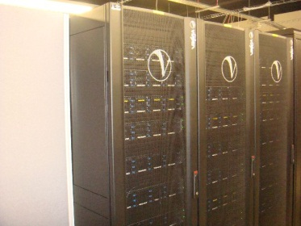
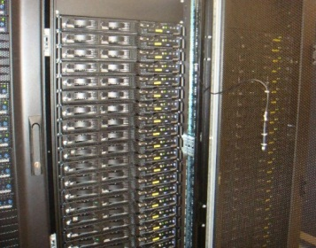
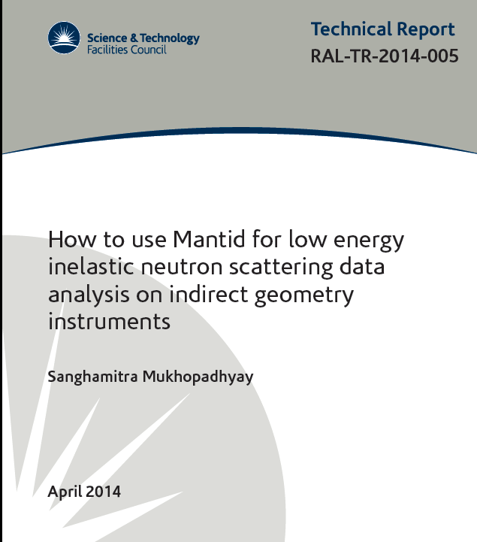
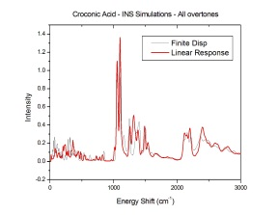
Data Interpretation in Mantid: Materials Modelling
Materials Modelling
e.g. (CASTEP, VASP, DLPOLY)
1548 processors on SCARF-RAL for Materials modelling
Ω
nMoldyn
Python Wrapper
Experiments
MANTID
Notes:
ARCHER (Edinburgh; apply ‘beam time’!)
nMoldyn (looked after by Mark Johnson at ILL): molecular dynamics calculations (CASTEP,: 512 atoms or 348 on SCARF) ; ViennaAbinitioSimulationProgram, DLPOLY 10^3 – 10^4 on ARCHER) and produces the outputs
e.g. Zeolite + water: melt the water (in the computer), follow trajectories into the zeolite => compute anything e.g. diffusion contants, correlation fuctions, MSQ, S(Q,w)….
Have written the python wrapper

Slide 24
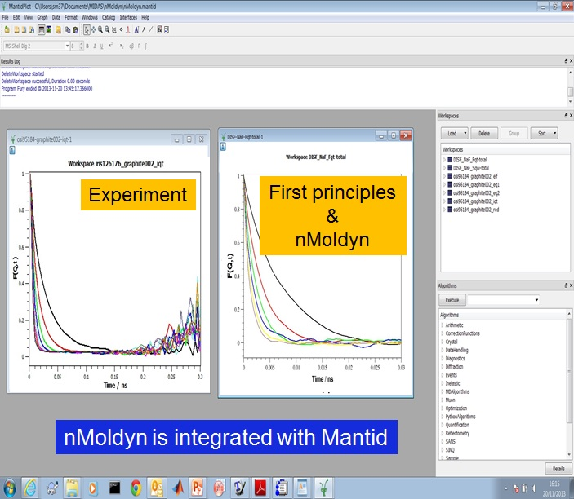
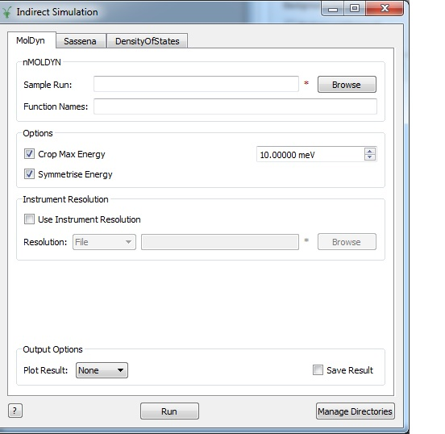
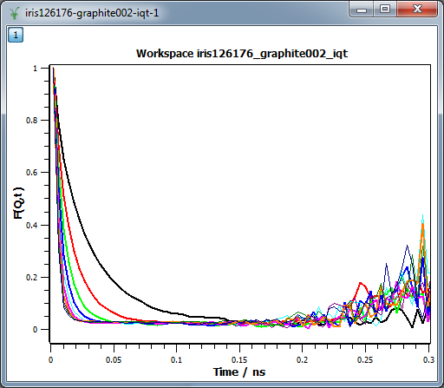
Data Interpretation: First Principles Simulation
Indirect Simulations interface
Experiment
Notes:
The data is from NaF molten salts at 1300K. At different Q i.e. I(Q,t)
The limitations in the simulations are small cell size (512 atoms) and small time scale (50ps)
The limitations in the experiment are instrument resolution and finite dynamic range.

Slide 25
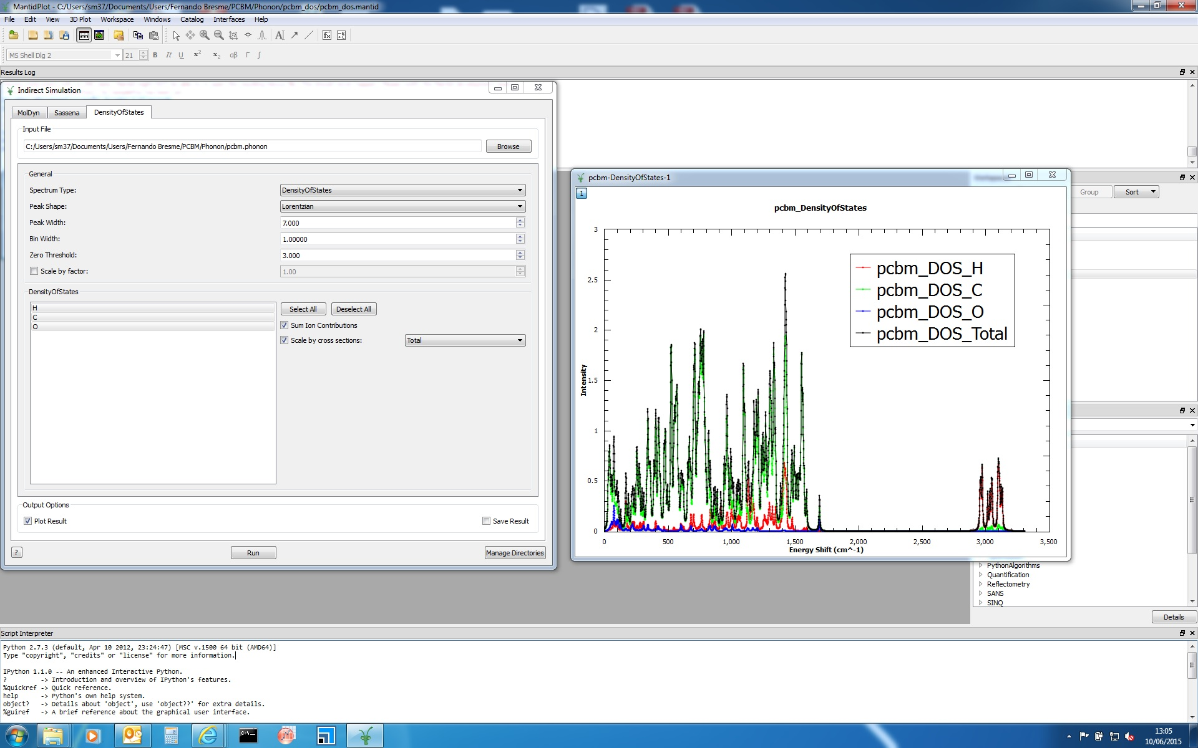
Data Interpretation: First Principles Simulation
VDOS from CASTEP is integrated with Mantid
Notes:
For compariosn on TOSCA:
Cannot calculate S(Q,w) yet – visual comparison: which peaks come from C, O, H etc.

Slide 26
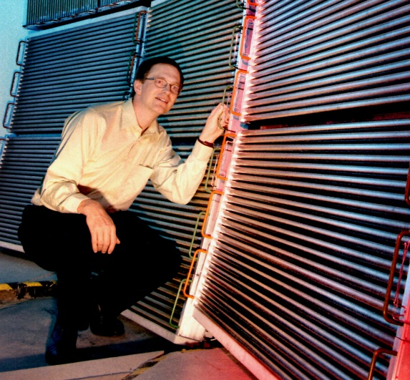
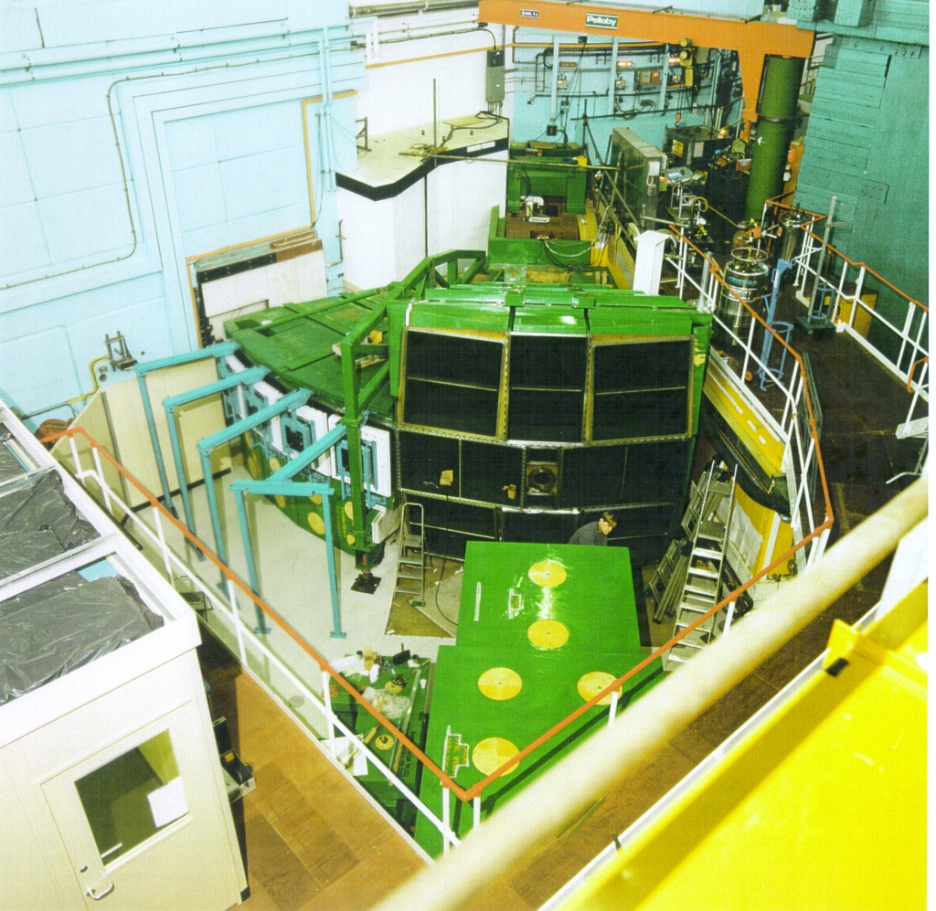
Direct Geometry
~10⁵ detector elements
~500 energy bins
100-500 runs
➔ 10¹⁰ voxels
MAPS spectrometer (ISIS)

Slide 27
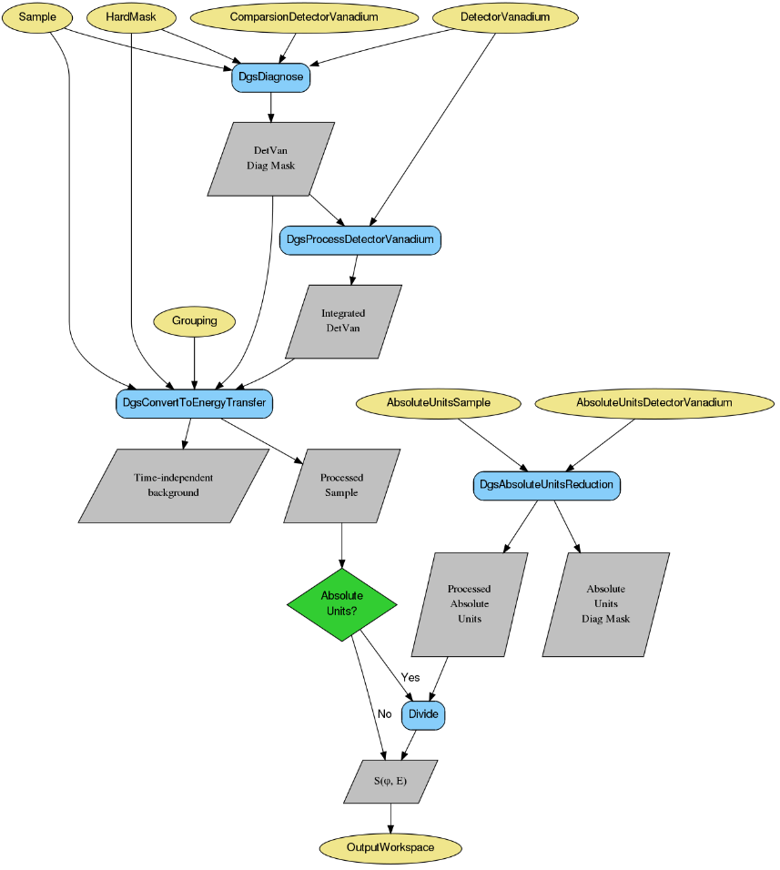
Direct Geometry data reduction
GUI
Script with a few parameters:
Sample run, white beam van, mono van run
Ei notional
Background integration time range
Autoreduce: web-based interface to set up as background process
Not yet polished: want to hide more
Powder diffraction, SX diffraction will follow

Slide 28
Multi-dimensional data visualisation: Objectives
Represent n-dimensional data in the complete manifold of interest
Efficiently handle sparse as well as dense n-dimensional data
Operate on such data very quickly and also use Mantid’s plugin framework to add new algorithm features
Visualize massive data sets in n-dimensions
Have these tools work for more than just one technique area
Simulation and fitting
Notes:
A summary of the high-level objectives for the VATES (Visualization and Analysis Toolkit ExtensionS) Project. Now fully integrated into and indistinguishable from Mantid.
This subproject is an ongoing effort and collaboration between ISIS/SNS and ESS.

Slide 29
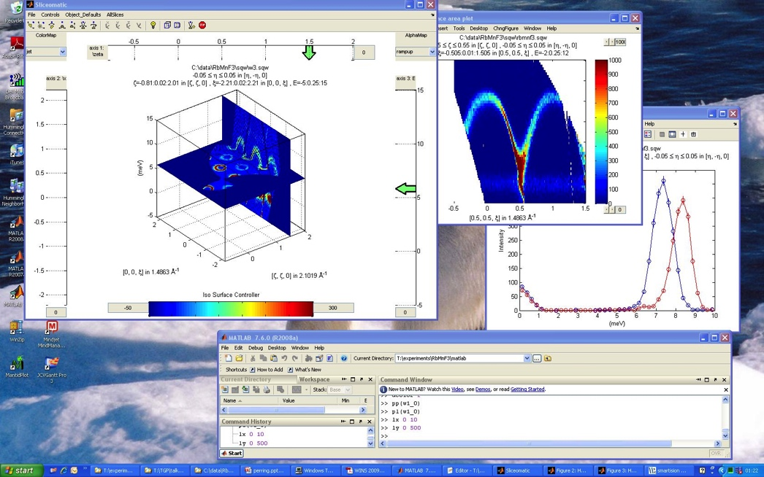
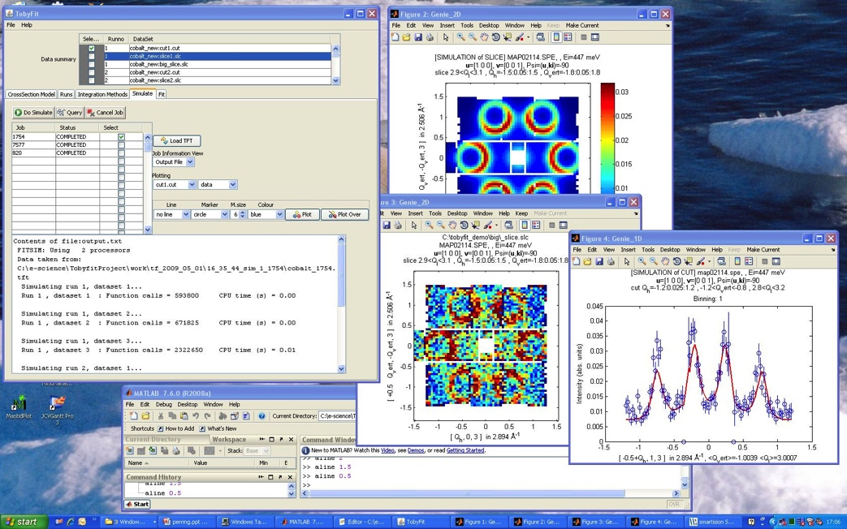
Seeding projects
Horace
Dave
MSlice
ISAW
Tobyfit
Notes:
This is not a project in a vacuum. Lots of prototyping and seeking of knowledge and experience from previous projects. As well as emulating successful features, we have tried to learn from mistakes. Having a diverse and multi-disciplinary development team with direct access to instrument scientists is key.

Slide 30
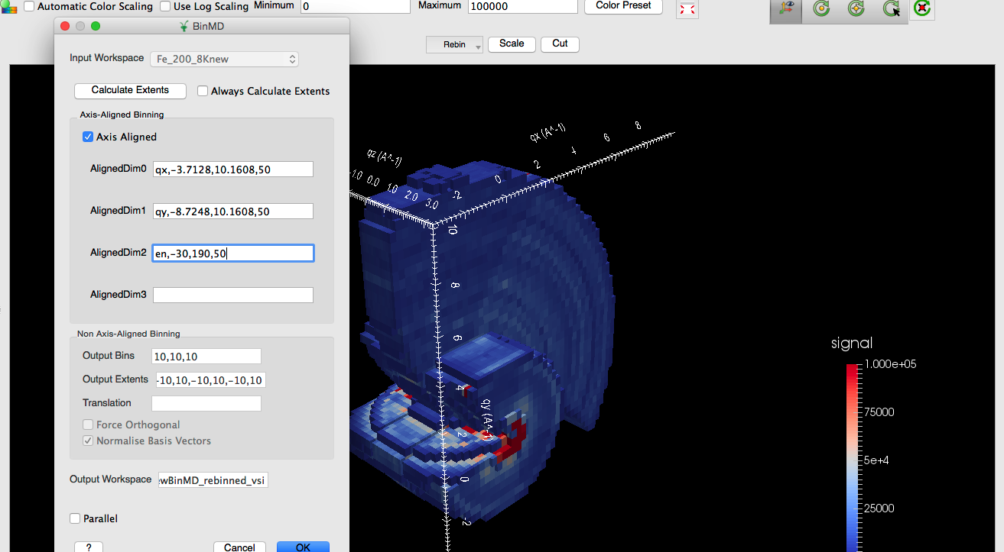
In-situ Rebinning
Notes:
Taking a 4D SQW dataset and integrating, out the qz dimension, and mapping delta energy to the y direction.
Omitting a dimension is equivalent to integrating it out for BinMD. We also have a Horace style CutMD available from the Rebin drop down as well as the pixel-preserving SliceMD.

Slide 31
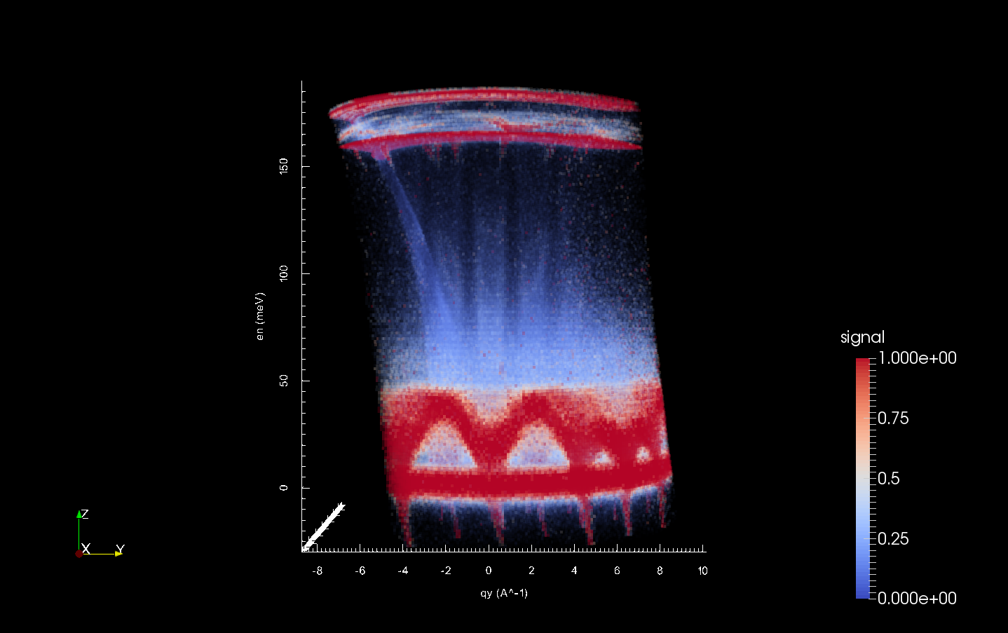
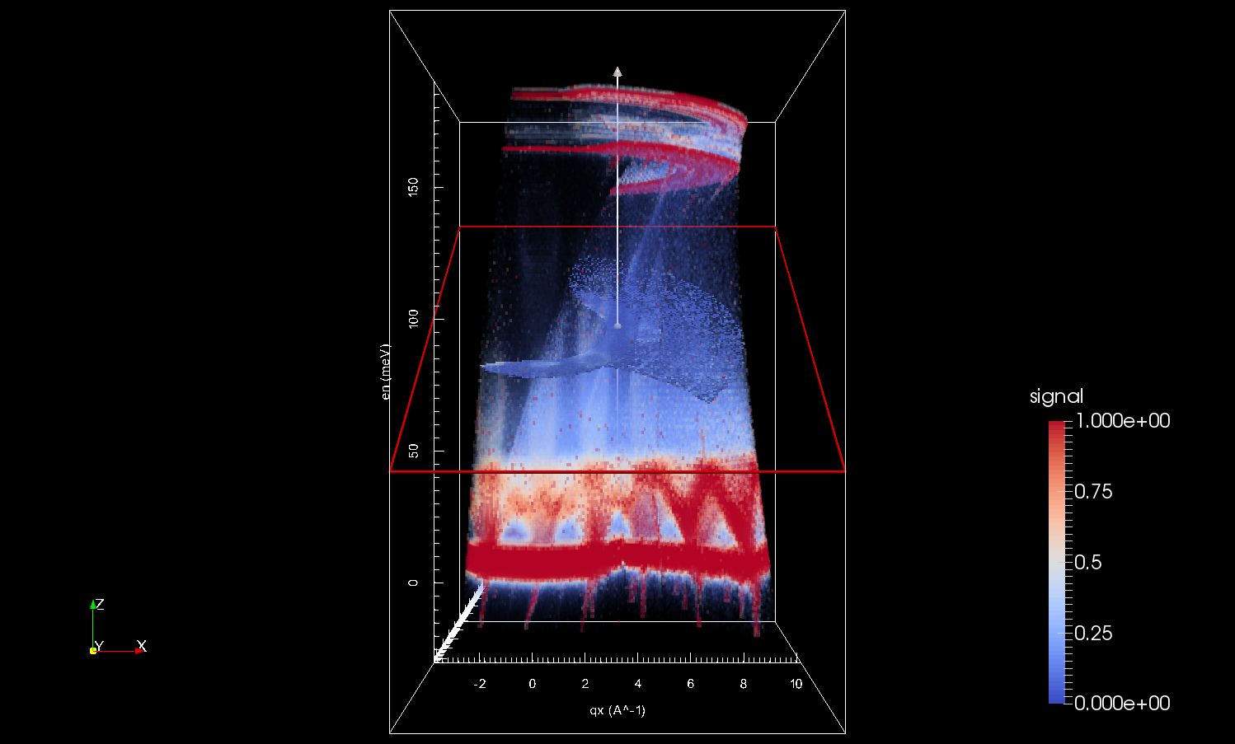
nD Visualisation
Fe 200Ei 8K
Notes:
Reduced data sets from multiple scans merged into a single multidimensional dataset. One reciprocal space dimension integrated out and visualized volume projection. All dimensions then rebinned uniformly inside the visualization window. All done in the Mantid application. No external tools needed. 28GB on disk but interactively visualized in 16GB RAM due to a large number of tricks and optimizations implemented in Mantid. We can also represent a 4th dimension on the time axis if we wish.

Slide 32
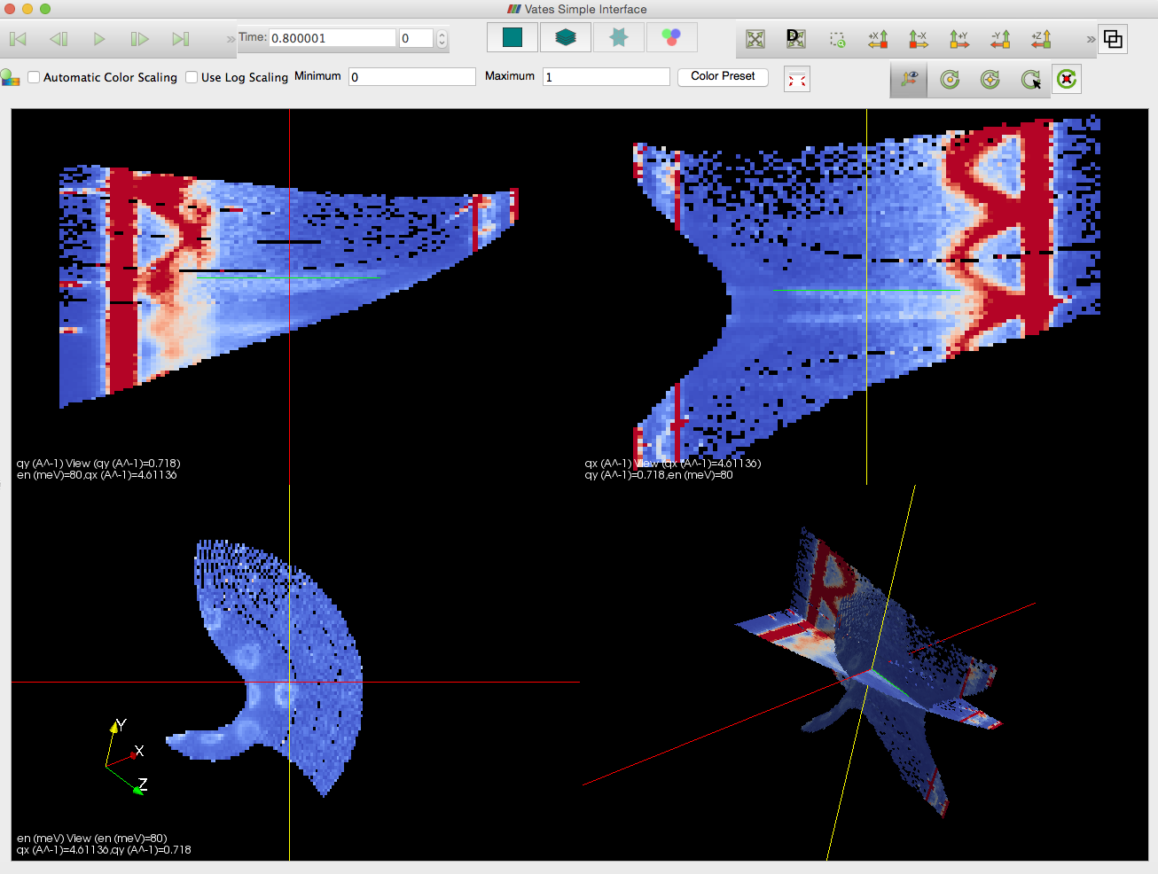
Switching to Three-Slice View
Notes:
Customized views allow us to view the data in various ways. We can switch between views at will. Here 3 orthonormal slices are created and can be moved independently.

Slide 33
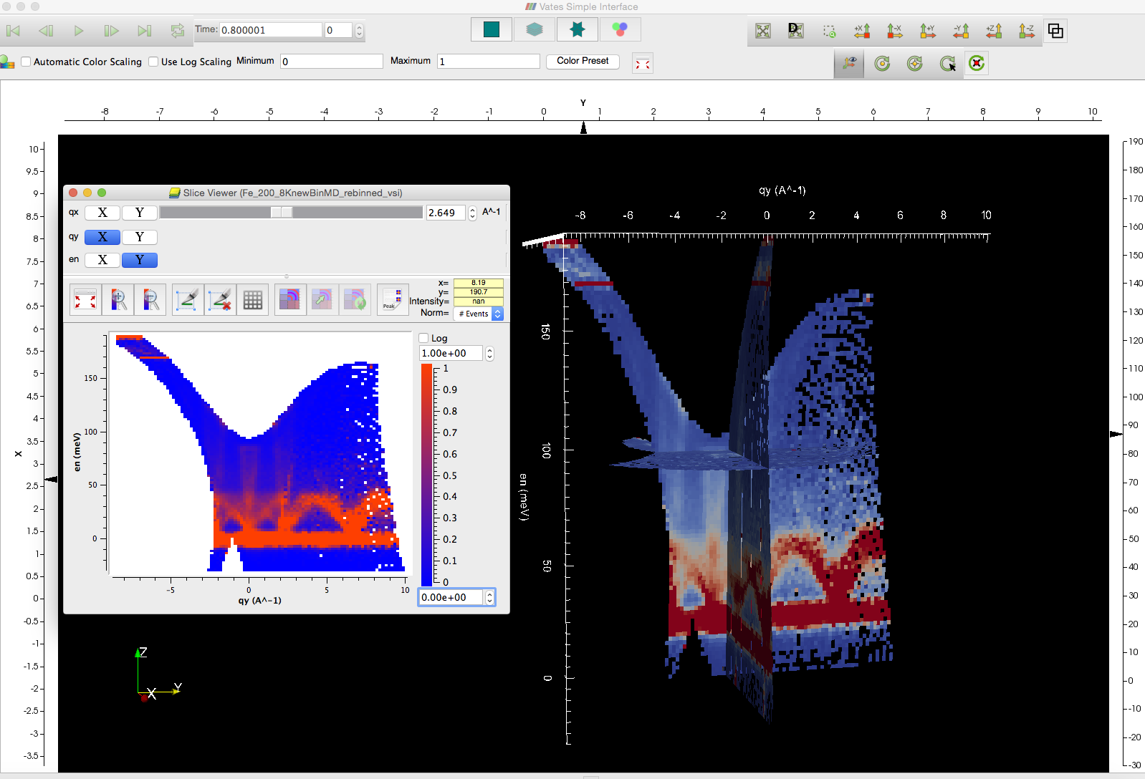
Switching to Multi-Slice View
Notes:
Multi slice view. From the arrow markers in our 3D visualization, we can launch the 2D slicing tool at an exact point. Many of our visualization tools know how to shake hands like this.

Slide 34
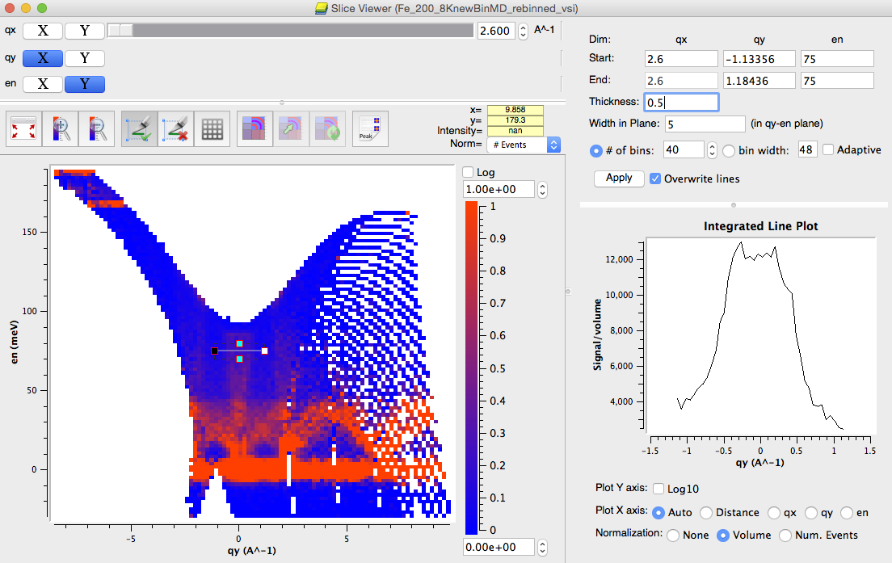
2D Slicing and Plotting
Notes:
Our 2D slice viewer has several very powerful inbuilt tools. One for which is the line viewer mode. So we can further reduce our data down to 1 dimension. Further rebinning may be performed to improve statistics.

Slide 35
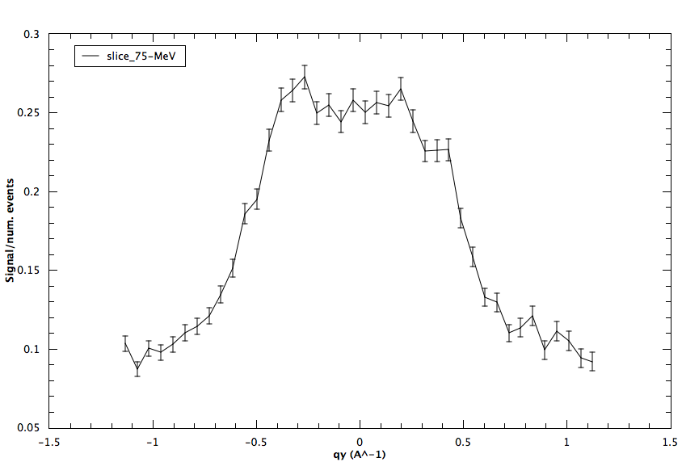
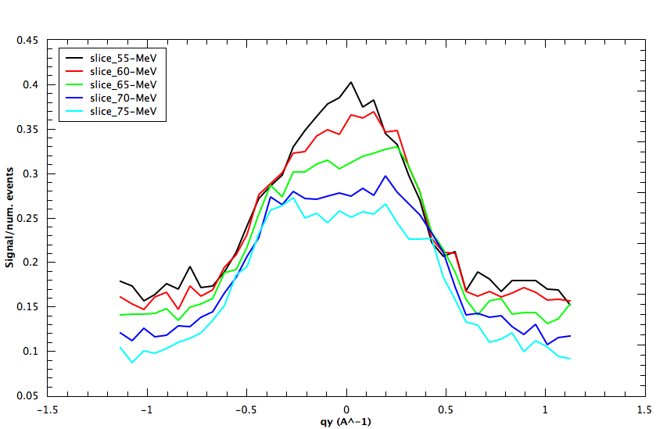
1D Plot
Notes:
Easy to programmatically or graphically move our line cut to other positions and overlay the results. The following plots have been created from the 2D slice above.

Slide 36
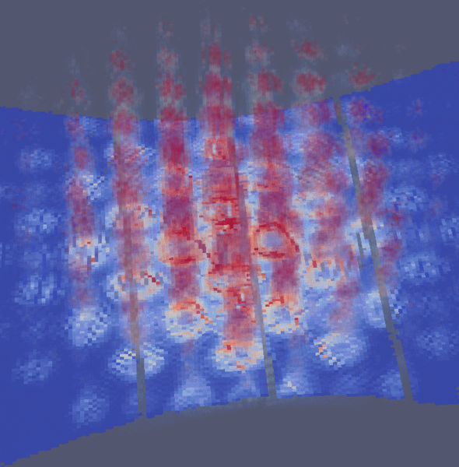
Ongoing Work
Horace Commands
Simulation and Fitting
Usability
Visualisation speed
Simulation of MERLIN instrument resolution convolved with a SrFe₂As₂ model
Notes:
We have a large amount of going work in this area.
Simulation and fitting is and active area of development using Toby fit as a template.
A number of the tools shown in the previous slide work very well and are critical for use in other technique areas such as SCD.
Cross-platform, multidimensional tools that work across technique areas are difficult to build. Making these tools easy to use is not trivial. Further to this, some operations are best performed via a command line interface form. We endeavor to provide both.
We have plans to make the visualization tools much faster. We hope to realize these plans in the coming months.

Slide 37
Single crystal diffraction
L1 = 40m
8mm * 8mm pixels @ L2 = 2.2m
Coverage ~360º in plane, 30º out of plane
1520 tubes x
128 pixels x
5000 tof channels =
18Gb / dataset

Slide 38
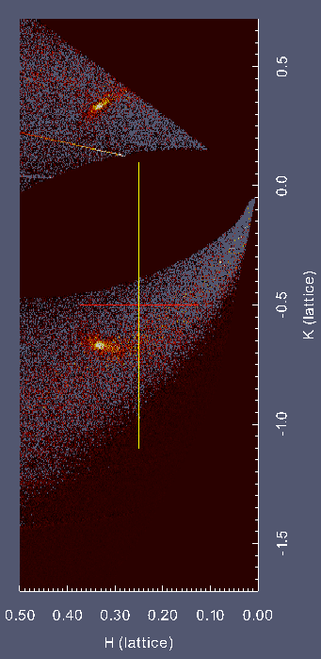
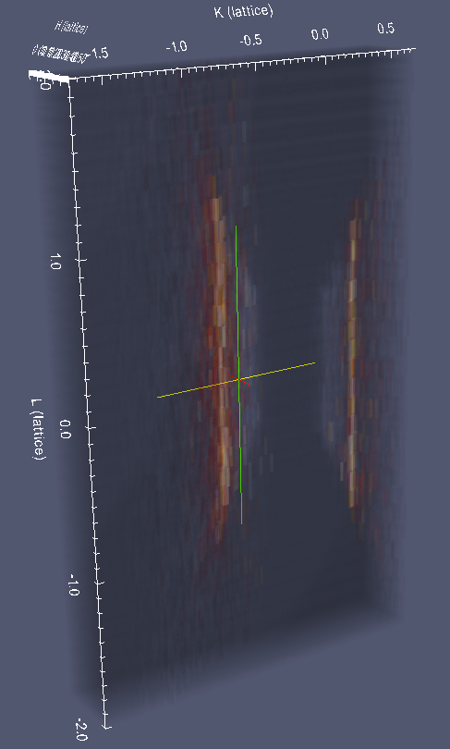
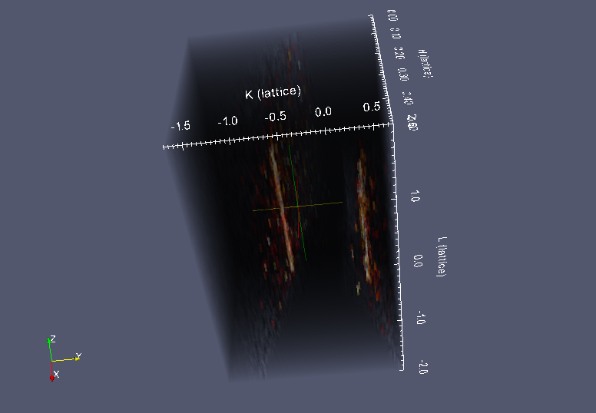
A Recent tough diffuse experiment
PdCrO₂ orders at 37.5K
Diffuse scattering in H,K Plane accessing
1/3 1/3 l, & 1/3 -2/3 l
<1x1x0.1mm crystal
aligned
in basal plane
10, 35 38.5 & 150K
20 hours per run
38.5K data
VATES
Notes:
fjshgdasg fhg
38
(1/3,1/3 ,L) (L=integer)
Just above TN rod like diffusion
Peak search
Get UB matrix
Convert to hkl
Shove it in the generic mNd viewer
VATES – VSI

Slide 39
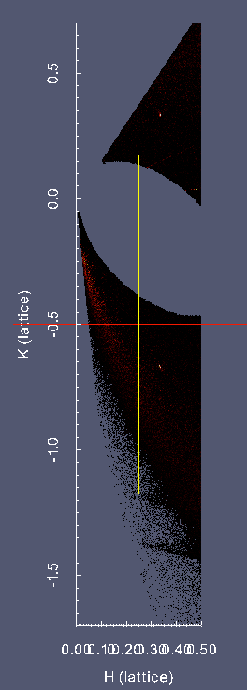
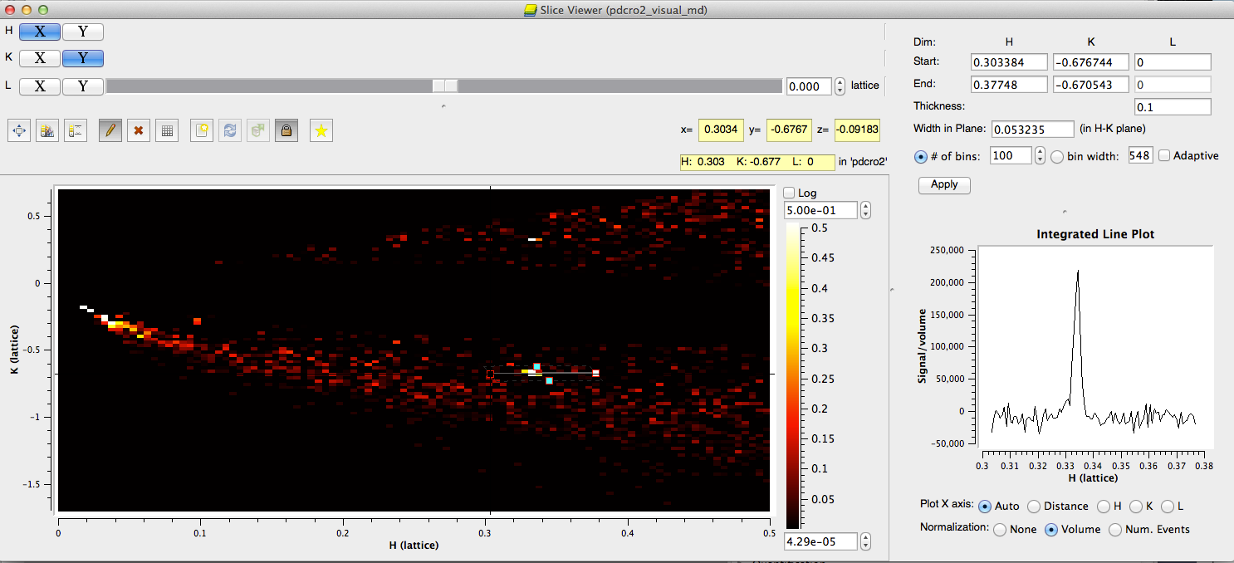
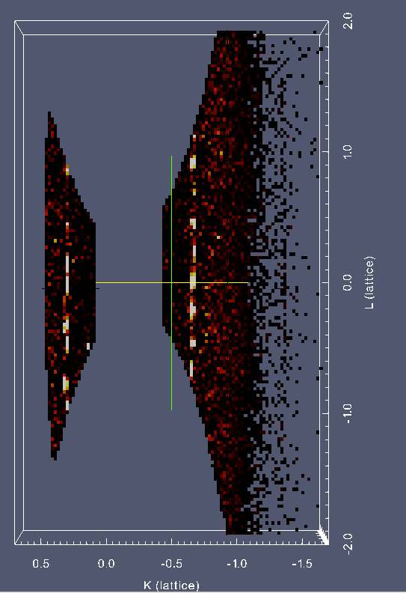
A Recent tougher diffuse experiment (2)
35K : T<T_{N}
Slicing through the data :
Resolution limited Bragg peaks
S. Dugdale, S. Giblin, J.W. Taylor
to appear in Sci. Reports
Notes:
fjshgdasg fhg
39
Now below Tn – sharp peaks along L (bottom right))
Then go to sliceviewer – see peak width – resolution limited.

Slide 40
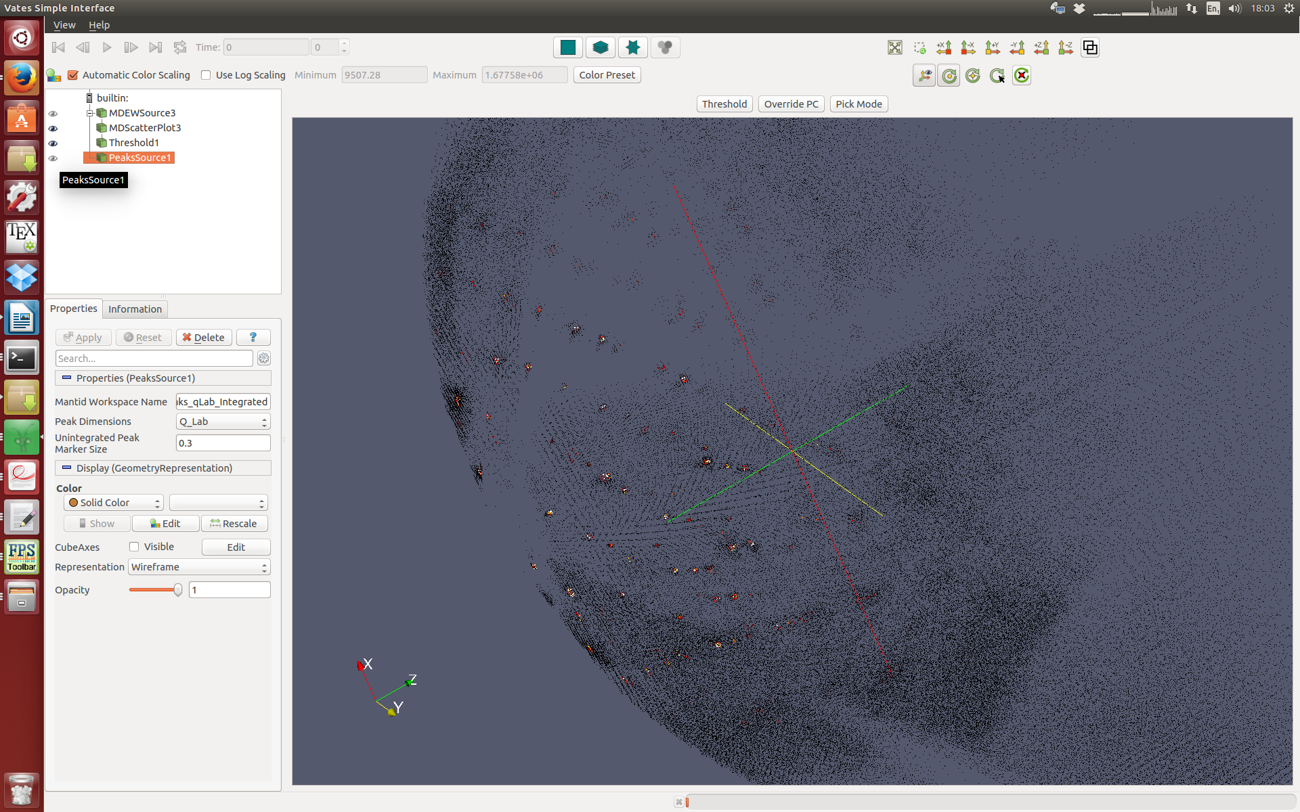
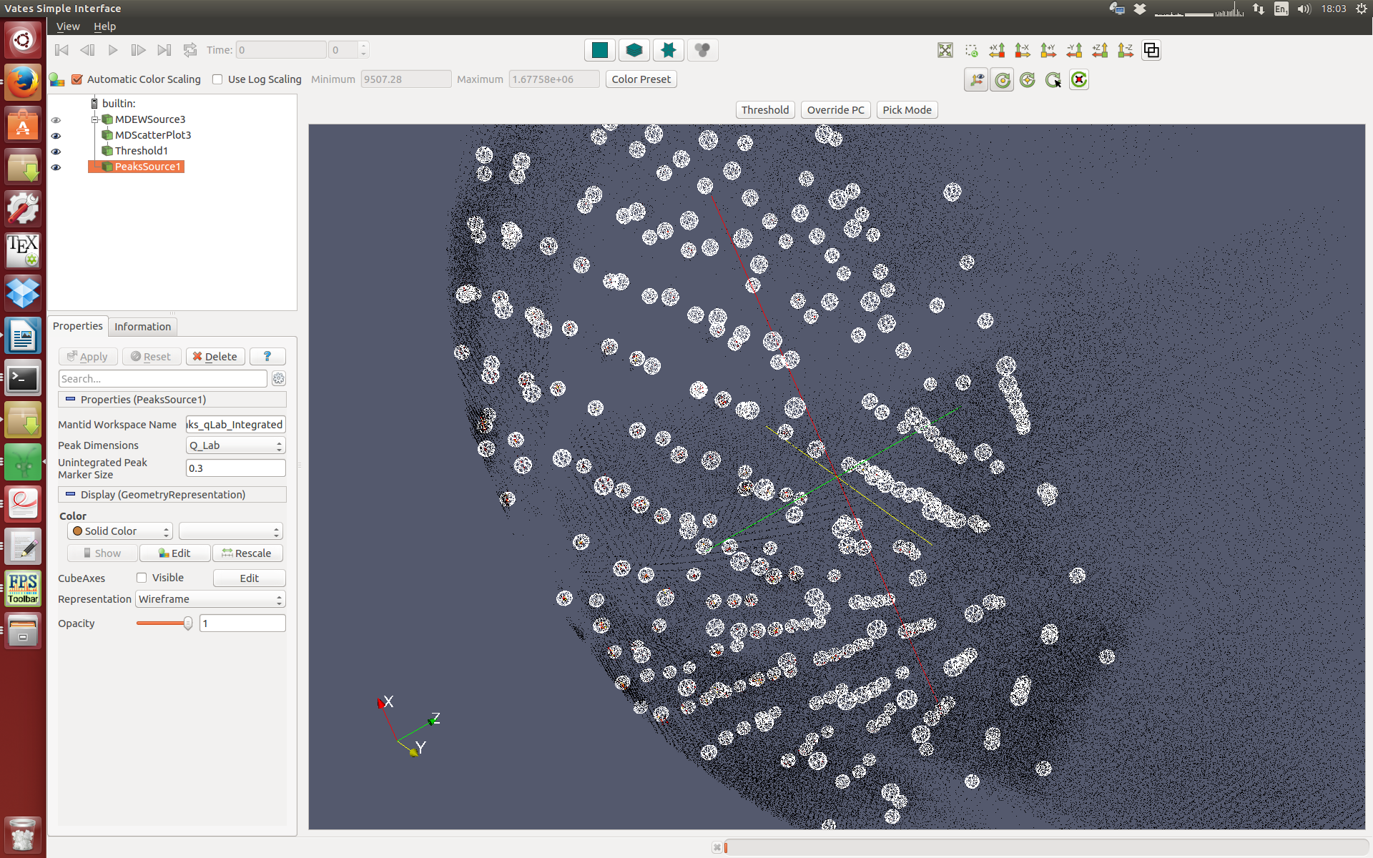
Use of VATES for showing integration boxes
NaCl SXD data plotted in q-space.
Spherical integration used here but elliptical and cluster models are also implemented. Get table of peaks
Can zoom in (with auto rebin) on peaks directly from peak list.
Notes:
fjshgdasg fhg
40
SXD on NaCl
Loads of peaks (default view)
Findpeaks – get UB and refine UB
Algorithm to integrate peaks (spherical, elliptical,cluster of ellipsoids built up in algorithm)
hklIE as a big list; export => FullProf or your favourite refinement package.
Overplot to see if you’ve integrated properly;
- select a particular peak from the tabel, zoom in, close examine – all very rapidly (New)
PS/ axes can be labelled – just not here.
Later: CiF file atomic positions + symmetry info; will be able to simulate and look on same footing as data.

Slide 41
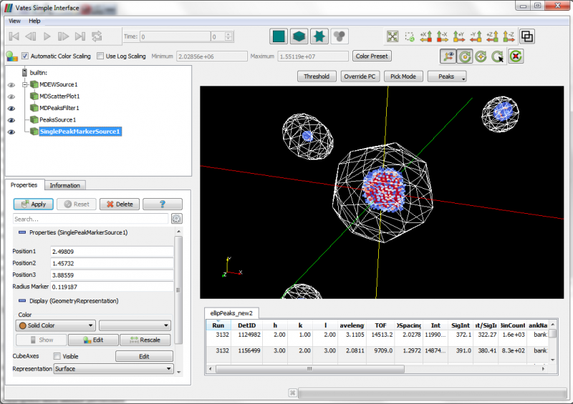
Notes:
We have a large amount of going work in this area.
Simulation and fitting is and active area of development using Toby fit as a template.
A number of the tools shown in the previous slide work very well and are critical for use in other technique areas such as SCD.
Cross-platform, multidimensional tools that work across technique areas are difficult to build. Making these tools easy to use is not trivial. Further to this, some operations are best performed via a command line interface form. We endeavor to provide both.
We have plans to make the visualization tools much faster. We hope to realize these plans in the coming months.

Slide 42
Data Analysis of disordered materials
…

Slide 43
Data Analysis of disordered materials
ISIS disordered materials group content with current data reduction and analysis software
Gudrun (data reduction)
Easy to use
Well-trusted
EPSR (modelling)
‘Gold standard’
Mantid requires additional algorithms:
Multiple scattering
Placzek corrections
Tough demands on current algorithms
Validation a large job
BUT:
If starting from the beginning…
Longevity
Notes:
If you are starting from scratch

Slide 44

Future Tasks

Slide 45
Future Tasks
Multiple Scattering Corrections
Integration with Third Party simulation codes
- McPhase, SpinW/Spinwavegenie, Gaussian, CASTEP etc
- Simulation first, Optimisation later
Better use of facility / cloud resources
- Remote desktop – Performance and stability
- Client server Mantid
- Web based UI
- Parallel visualisation rendering

Slide 46
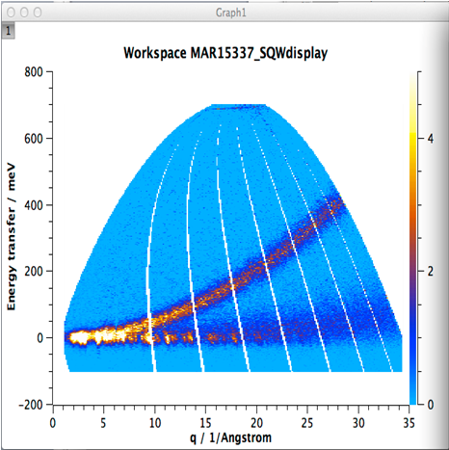
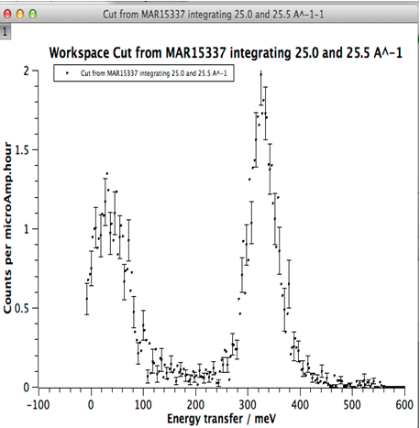
Intelligent Run Control
Future Tasks
Define Region of interest
Define error bar criteria
BEGIN Run
Update from DAE & Reduce data to S(q,w)
Calculate statistic for ROI
Does statistic meet criteria
NO
YES
END run

Slide 47
Future Tasks
Technique specific developments
Support for imaging instruments
Liquids, amorphous, PDF analysis
Inelastic: resolution convolution
Further planning tools
:

Slide 49
ISIS -> SNS
SNS -> ISIS
Robust framework
Common development structure
Multithreaded performance
Documentation and training
Automated build, test and deployment
Algorithms
Over 150 algorithms already developed
Development support
help
Improvements to build process
Cmake, Hudson
Event Filtering and data analysis
Improved python code framework
Autoreduction system
New file format support
NxSPE
Event Nexus
Paraview, Kitware contract, VSI

Slide 50
SNS -> ISIS
Improvements to build process
Cmake, Hudson
Event Filtering and data analysis
Improved python code framework
Autoreduction system
New file format support
NxSPE
Event Nexus
Paraview, Kitware contract, VSI
Notes:
Not a comprehensive list. Point is: Identified gain at point of joining was a freaction of what Mantid gained; …and opther wayu round of course.

Slide 52
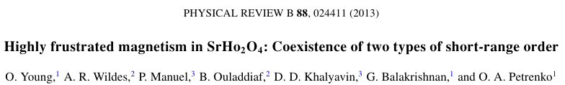


Magnetic diffuse scattering
Zigzag chains connecting
Honeycomb layers
2 Ln sites
0.9g sample. Ho³⁺ big moment
2013 : Using slice viewer with WISH data
Diffuse scattering k=0 type.
Also D7 (and D10) data in different planes.
Rod like features in h0l along l=1/2 integers
→ 1d- correlation in real space.
Notes:
fjshgdasg fhg
52
2 La sites
Two type SRO fropmt he two chains
MC code simulates J|| / Jdiag (4 Js => 3 d.o.f.)
Python code to do MC; read back in to Mantid, compare
‘Optimisation by eye’

Slide 53

Horace style commands
CutMD
CreateMD
SmoothMD
EvaluateFunction
…
Notes:
We want users familiar with Horace commands to be at home in Mantid. We use Horace as a driver to fill the missing Algorithms in our toolset, for algorithms we already have we create aliases or WorkflowAlgorithms to repackage them for our Horace consumers.

Slide 54
SANS Data Processing at ISIS
Multi-facility collaborations involving ISIS
DAQ
NXS file
Sample changer control script
Mantid
reduced data file
(1D: XML / TXT; 2D: TXT / HDF)
Mantid planning to implement ‘workflow processing’
Analysis Programs
ATSAS
dummy atom / shape envelope modelling for biological systems
SASSIE
MD modelling of biological and soft matter systems
open source
www.ccpsas.org
SasView
model / curve-fitting
open source
www.sasview.org
Other
Eg;
correlation function analysis

Slide 55





‘Instrument View’
functionality divided between multiple ‘tabs’
configuration file
1D Reduced Data
(radial average)
range of output data formats
option to enter run
numbers interactively
(as shown) or process
multiple data sets from
a spreadsheet list
2D Reduced Data
Transmission Data
Mantid for SANS

Slide 56

extensive model library
1D & 2D
fitting
Open source
Python / C++ (like Mantid)
Multiple optimisers
Nuclear & magnetic scattering
Developers from:
NIST
SNS
ISIS
ESS
ILL
ANSTO
TU Delft
more welcome!
data & fit
polydispersity & smearing
residuals
individual,
simultaneous,
or batch modes
of operation
control of fit range
SasView

Slide 57


Slide 61

What we can do: MantidPlot

Slide 62
QENS Data Reduction in Mantid
Instrument
Analyser
Reflection
Transmission
Detectors

